Slide 1
Applied Data Science
Topic 11c – Part 3
Notes:
Hello and welcome to the last part of Topic 11c, Applied Data Science. During this topic I'll introduce what data science is, the basic principles underpinning data science, and some important data science tools that may be unfamiliar to you. My name is Dr. Robert Lyon, and I’ll be taking you through the learning material.

Slide 2
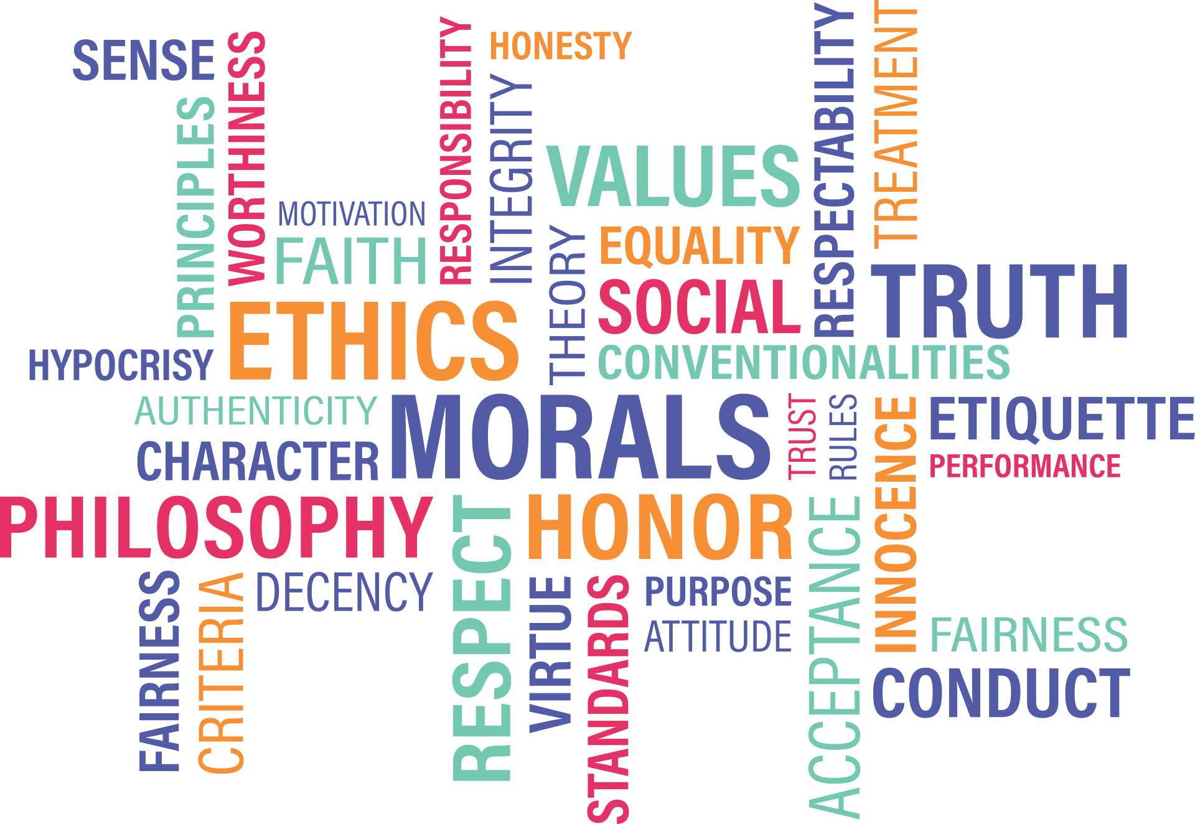
1. What We’ll Cover
The aim: to provide a overview of some of the ethical issues faced when applying data science, why these are important, and how to ensure responsible working moving forward.
Notes:
What material will we cover during this final part of the topic? Well, here we’ll cover some of the ethical issues that must be considered when working in modern data science. This may involve thinking about the ethics of applying automated methods for decision making, of collecting and storing data, and perhaps even replacing traditional job roles via automation.
The aim: to provide an overview of some of the ethical issues faced when applying data science, why these issues are important, and how to ensure responsible working moving forward.

Slide 3
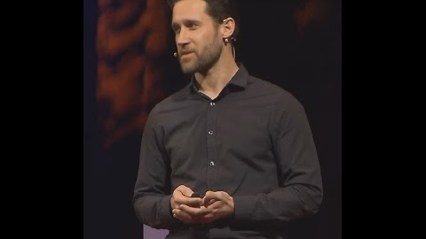
2. What are Ethics?
Credit: Tedx, Dr. Michael D. Burroughs
Notes:
Before proceeding any further, its worth reflecting on what Ethics is all about. When ready, watch the video (https://youtu.be/_8juebyo_Z4) shown on the slide. The speaker introduces an interesting idea – that we are all ethicists. “Everyday ethicists” in fact, that make ethical choices and decisions all the time - whether we realise or not.

Slide 4
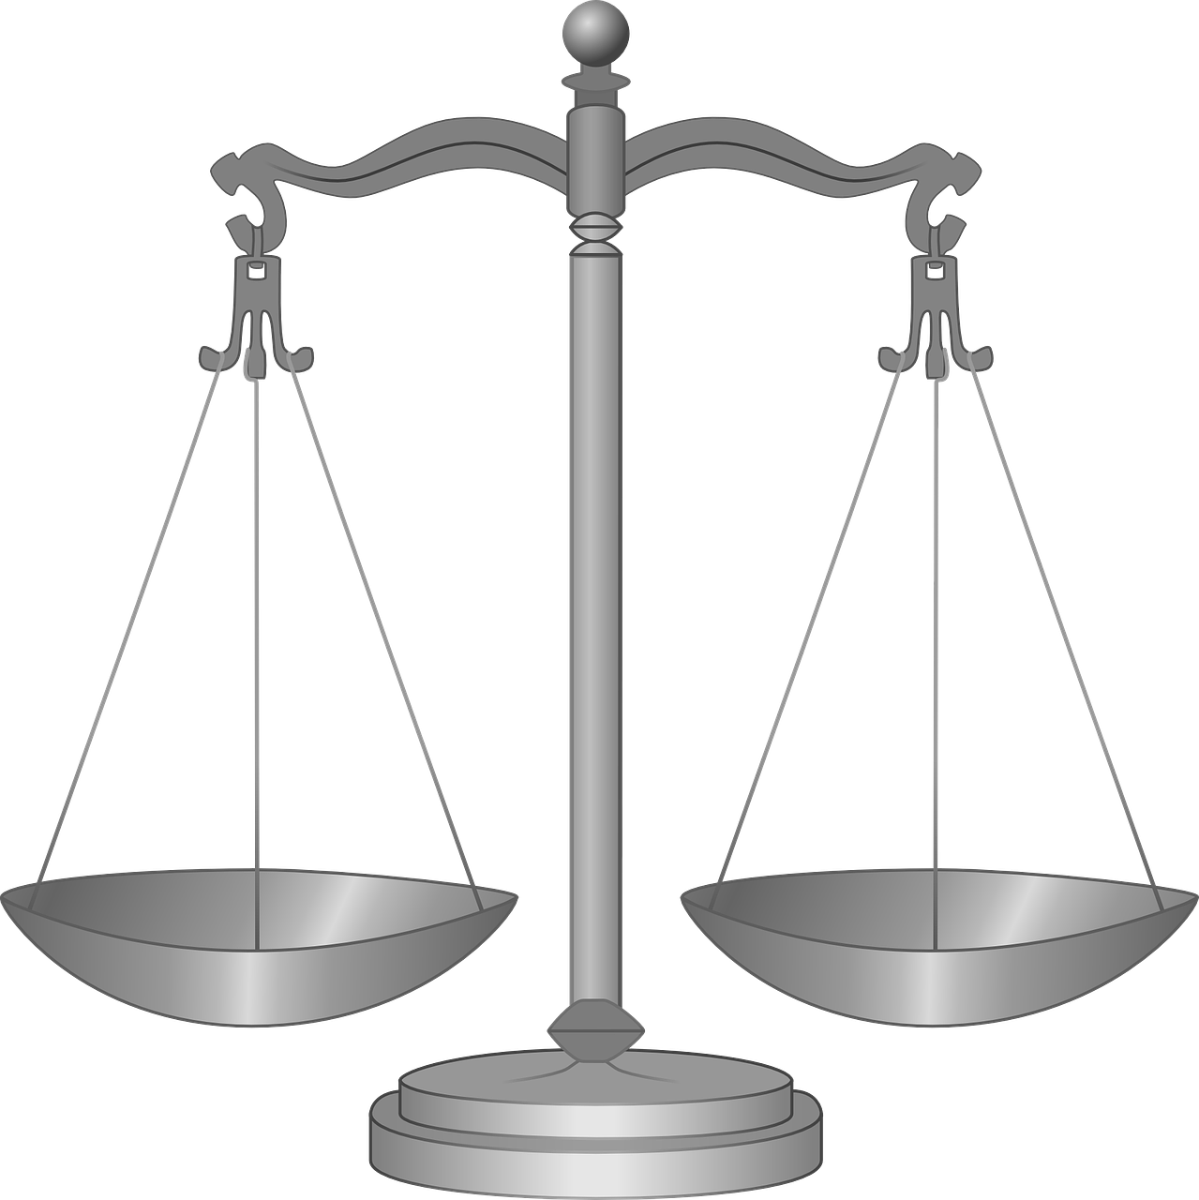
3. What are Ethics?
Ethics is a branch of Philosophy - it systematizes right and wrong.
Deciding right from wrong is tricky. It involves choosing a metric to compare against, such as the “greatest good” - the best behaviour yields the greatest good.
Good
Good
Notes:
The idea that each of us is an everyday ethicist is an interesting one. To understand what sort of ethicists we may (or may not!) be, it’s worth restating what ethics is all about.
Ethics is a branch of Philosophy that systematizes the interpretation of right and wrong. This allows different forms of conduct to be compared and contrasted. We can then judge which approach we determine / believe to be correct or “right”. This is of course just one definition that I’ve proposed. There are many more available which I encourage you to seek out in your own time.
Deciding what is right and what is wrong is a tricky business. It involves choosing a metric against which you can compare, such as the “greatest good”. Here the best form of behaviour is that which yields the greatest good.
This view is still open to interpretation and interrogation – what is good and bad can vary.

Slide 5


4. What are Ethics?
Stoicism - behaviour that brings about contentment and serenity achieves the greatest good.
Hedonism - behaviour that maximizes pleasure and minimizes pain achieves the greatest good.
Utilitarianism – behavior that maximizes a positive effect, e.g. happiness, achieves the greatest good.
This isn’t a full ethics course, so we can’t review all the theories.
That said, we’ll press on and use utilitarianism as our focus point.
Notes:
For example, here are some ethical theories and their approach to good and bad.
Stoicism - here behaviour that brings about contentment and serenity achieves the greatest good.
Hedonism – here behaviour that maximises pleasure and minimizes pain achieves the greatest good.
Utilitarianism – behaviour that maximises a positive effect, for example happiness, achieves the greatest good.
This isn’t a full ethics course, so I can’t (as much as I may like!) review all the theories out there. Instead we use an established theory as a springboard for learning. I won’t be providing my own personal opinions here, given that you may have a very different interpretation than me. It’s not my place to decide what is right and what is wrong.
That said, we’ll press on and use utilitarianism as our focus point.

Slide 6
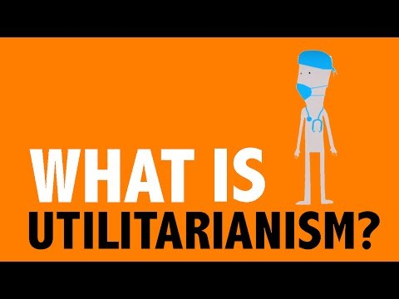

5. Utilitarianism
Part 1
Part 2
Credit: Wireless Philosophy, Julia Markovits
Notes:
Utilitarianism describes a collection of ethical theories underpinned by the following general idea: that the greatest good is achieved through the maximisation of happiness. This is a simple view which superficially appears to be logically sound. Let’s watch the two videos (part 1: https://youtu.be/uvmz5E75ZIA and part 2 https://youtu.be/uGDk23Q0S9E) below which will help us judge if that impression holds true.
During these videos an associate professor from Cornell University that specialises in Ethics (and is therefore a better teacher than me in such matters!), will talk you through Utilitarianism. You may find that while this theory has many positive attributes, it has some unfortunate negative implications. This is true of most, if not all ethical theories. Thus it is up to you to judge utilitarianism according to your own moral compass. The reason we introduce utilitarianism here, is to use this form of ethics as a springboard for ethical interpretation.

Slide 7
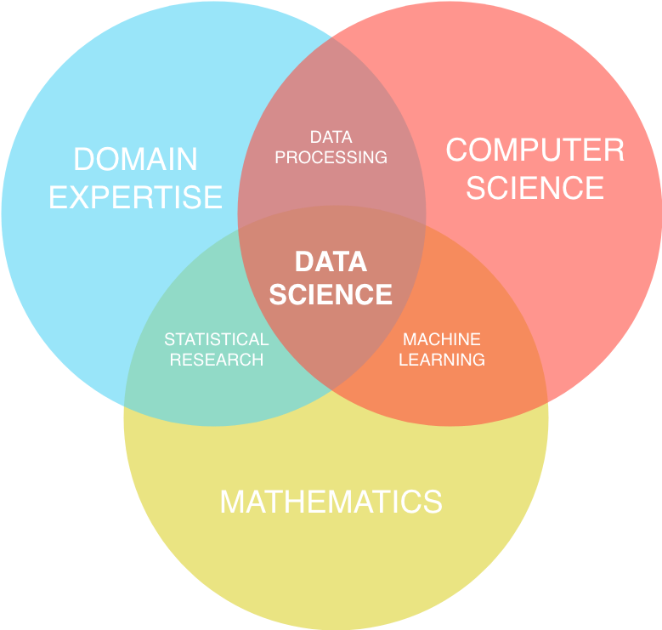
6. Relation to Data Science
Ethical questions related to the application of domain expertise to problems at hand.
Credit: Shelley Palmer & Crate.io
Notes:
We face ethical questions everyday. Just a few moments ago I faced a simple ethical choice. To refill the kettle in the work kitchen after making coffee; or to leave it for someone else to do. If we analyse this dilemma using utilitarian theories, which option produces maximum happiness? If I fill it, then the next person may be marginally happier, when they realise that someone filled it for them. If I don’t fill it, I save myself time so I can get back to the tasks have to finish. Whose happiness is more important here? I leave that for you to consider. In the end, I chose to fill the kettle – that seemed like the right thing to do by my own moral compass.
In data science, we’re faced with far more complex dilemmas across multiple areas. We face ethical issues arsing from,
The application of domain expertise to problems at hand. For instance, is it right to use algorithms to deicide which people to target with lots of credit, knowing full-well that poorer people will struggle to pay it back?. Consider a utilitarian perspective – if the company profits from this endeavour, they can provide dividends to shareholders which increases their happiness. Some poorer people may actually benefit from the credit line too, increasing their happiness. Offset this against those poorer people that cannot repay – the algorithms certainly didn’t help them. So whose happiness is more important here?

Slide 8
7. Relation to Data Science
The way in which data is collected, processed, cleaned.
Ethical questions related to the application of domain expertise to problems at hand.
Questions surrounding application of ML and A.I. in general.
Ethical questions related to research goals and methods.
Ethical questions related to the application / use of statistics.
Credit: Shelley Palmer & Crate.io
Notes:
There are more issues:
The way in which data is processed for use. For instance, when is it acceptable to process personal data? Is it acceptable to process the data belonging to men and women differently?
The application of machine learning. When is it right to apply learning systems – when automated systems are capable of saving more lives then a person? What about those who’d loose their jobs in this instance?
The application of statistics. Sometimes statistics may give misleading results due to the data they are applied to. If this is still the best we can do, is it right to apply such methods when we known mistakes may be common? For instance, statistics show that children from poor areas perform less well at A-level compared to children in affluent areas. Should these statistics be used to inform decision making – for example, UCAS decisions?
When conducting research. What sort of research is acceptable. What if the research can be used for negative purposes? Perhaps the best example of this lies in Physics. Unlocking the power of the atom allowed the human race to harness nuclear energy. It also led to nuclear weapons. Knowing that such weapons have been used, do you think it was right to pursue this research? The utilitarian view would likely consider this to be the right decision, given the long term “happiness” it produced.

Slide 9
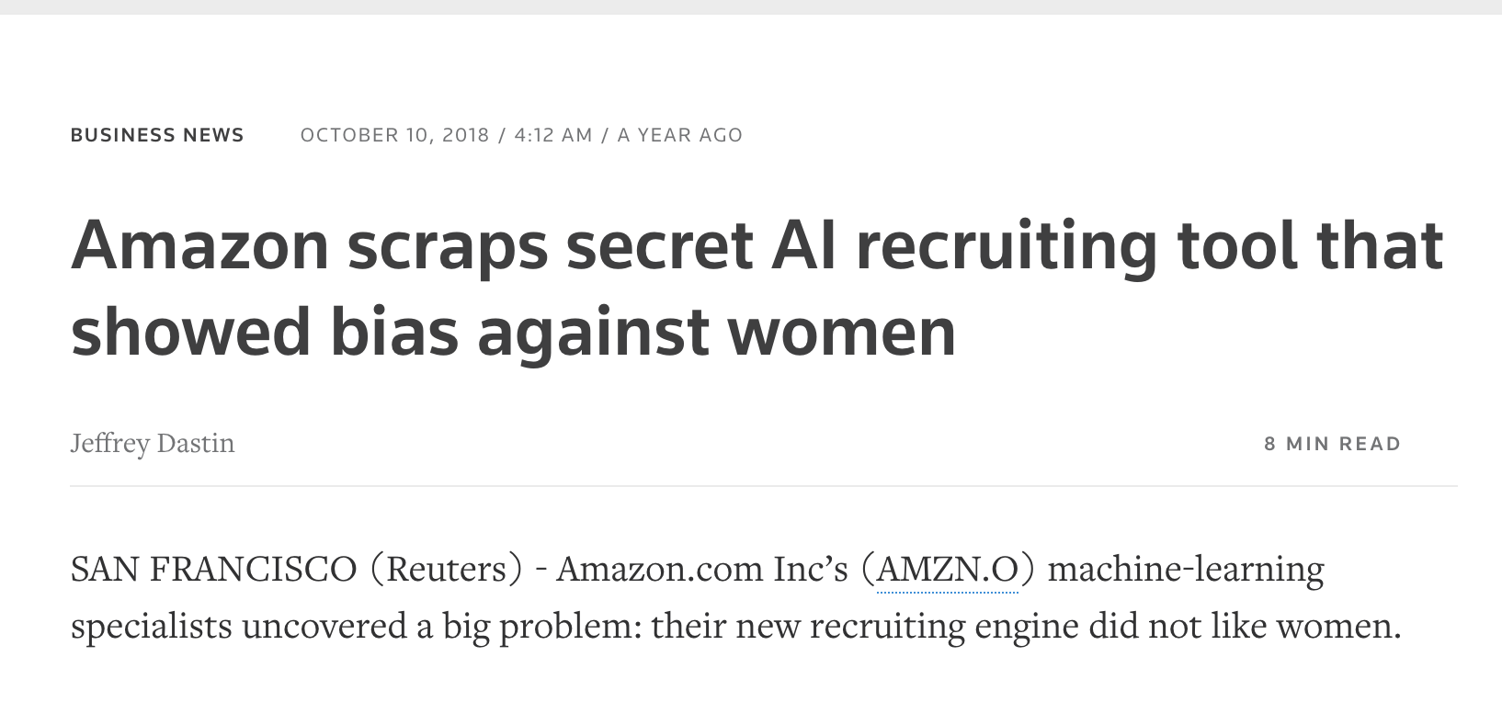
8. Importance & Fairness
Ethics becoming increasingly important as we relinquish human decision making responsibilities to algorithms.
These systems must operate in an ethical fashion.
Lets' avoid the “tyranny of algorithms”.
Mistakes have already been made. Perhaps unknowingly, a utilitarian style approach to building automated systems has been adopted by many.
This is because learning systems are usually trained with a singular purpose in mind – to achieve the best predictive accuracy. Consider an example:
Credit: Reuters
Notes:
Ethics are becoming increasingly important in a data driven automated world. If we we continue to relinquish human decision making responsibilities to algorithms and equations, we must ensure these systems must operate in an ethical fashion, otherwise we might end up suffering what I would call “the tyranny of algorithms”. Mistakes have already been made. Perhaps unknowingly, a utilitarian style approach to building automated systems has been adopted by many. This is because learning systems are usually trained with a singular purpose in mind – to achieve the best predictive accuracy. Here “achieve the best accuracy” is shorthand for “maximise accuracy” which should therefore maximise happiness. Consider an example. If a company trains a system to accurately recognise promising job candidates, one would assume more accurate systems are a good thing. Yet if that accuracy is achieved on biased data, we end up encountering unforeseen issues. Amazon, a company filled with PhD educated data scientists, built a system biased against women. Clearly this is not ethical and illustrates why ethics are needed. This raises the question of algorithmic fairness. Algorithms by themselves are not biased or bigoted. Data can be biased due to how it was collected, and when given to algorithms can cause unfairness. It is up to us as data scientists to be mindful of the data we use.

Slide 10
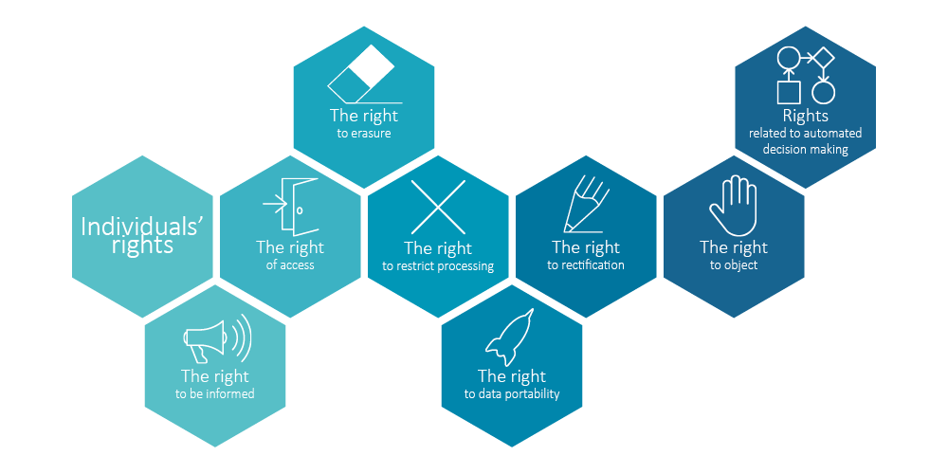
9. New Framework
How long it can be kept.
That it should be maintained in a secure manner.
That it’s integrity and data validity must be preserved.
That our consent must be sought before that data can be used.
The right to be Informed.
The right of access to our data.
The right to erase data held about us.
The right to demand our data repaired if erroneous
The right to object
Plus rights related to how automated systems use our data.
Credit: European Progress
Notes:
Ethics by themselves are not enough to prevent things from going wrong. Thus there is now a framework in place to help enshrine the rights we have over our personal data. This framework, the General Data Protection Regulation (GDPR) applies to the data of all citizens of the EU. It defines who owns our personal data – that’s us, and our rights over that data.
How long it can be kept.
That it should be maintained in a secure manner.
That it’s integrity and data validity must be preserved.
That our consent must be sought before that data can be used.
The right to be informed, to access our data, to erase data held about us, for the data to be repaired if erroneous, the right to object – and rights related to automated systems.

Slide 11
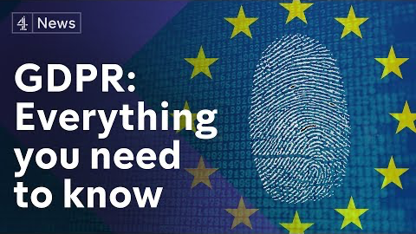
9. GDPR
GDPR is a legally enforceable framework that complements the ethical considerations we should already be making as data scientists.
With GDPR in place, we can ask a question of ourselves when facing a data science problem - is it ethically acceptable and legal to apply data science to the problem?
Is the potential application fair?
Credit: Channel 4 News
Notes:
GDPR is a legally enforceable framework that complements the ethical considerations we should already be making as data scientists. This means with GDPR in place, we can asks a question of ourselves when facing a data science problem - would the application of data science in this area be ethically acceptable and legal? Then we can ask ourselves is the potential application fair?
An action may be legal, but could be ethically questionable. Thus, we need to consider if just because we can, does that mean we should? One approach would be to mix in utilitarian ethics at this point – if it is legal, and would achieve a net increase in happiness, then surely it’s the ethically sound thing to do? Tax avoidance is technically legal, and no doubt greatly increases the happiness of the individuals avoiding tax. It will marginally annoy millions of us, but this loss in happiness may be less then the gain in happiness for the avoiders. So what is right in this instance. This is why I’m glad GDPR exists – it at least provides some protection for many of us. When ready watch the video (https://youtu.be/acijNEErf-c) shown on the slide to learn more about GDPR.

Slide 12
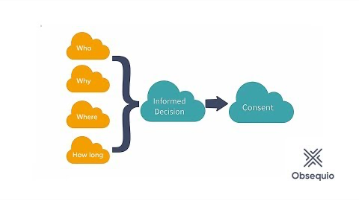
10. Consent
Consent is becoming an increasingly important issue in data science.
If data is being collected about us all the time, does that mean we consent to all it’s potential uses?
GDPR would now suggest that direct consent is needed if the data is to be processed in a new way.
What about data stored in mathematical models – users have rights over how there data is used here too.
Consent is at the heart of any data science activity that involves people and their data.
Credit: Obsequio Software
Notes:
Consent is becoming an increasingly important issue in data science.
If data is being collected about us all the time, does that mean we consent to all it’s potential uses?
GDPR would now suggest that direct consent is needed if the data is to be processed in a new way.
What about data stored in mathematical models – what about machine learning models? Well, users have rights over how their data is used here too.
Consent is at the heart of any data science activity that involves people and their data. When ready, watch the video (https://youtu.be/o3aYgr_mjKg) on the slide, to explore consent in more detail.

Slide 13
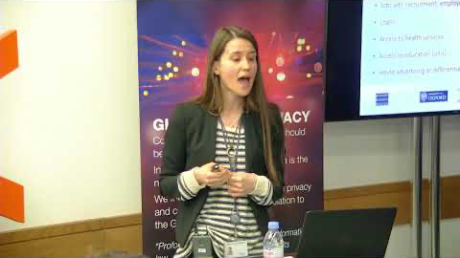
11. GDPR & A.I.
GDPR presents some unique challenges to A.I.
One important issues is related to the training of intelligent algorithms. These learn from vast quantities of historical data.
The data is used to build what we called models.
Under GDPR these models are derivates of user data, thus users have rights over them.
This can raises ethical questions.
Credit: Alan Turing Institute
Notes:
GDPR presents some unique challenges to A.I. Since data science often relies on A.I. to study data and make predictions, we must be aware of some of the GDPR issues surrounding this topic. One important issue is related to the training of intelligent algorithms. These algorithms learn from vast quantities of data. To improve their performance, it is desirable to provide them with historical data – perhaps personal data. This data is used to build what we called models. These are mathematical models built from the data of potentially many individuals. Under GDPR these models are derivates of user data, thus users have rights over them. If these individuals cease to consent to the use of their data – are the models thrown away? Can they be reconstructed without their data? What if the data is used in the medical domain. Suppose we face a situation where individuals can request their medical data be removed. Now suppose that their data was being used to construct an algorithms regularly saving lives. Removing their data will worsen the performance of the system. Yet legally this data would need to be removed. From a utilitarian perspective consider what achieves greater happiness – a person knowing their data has been deleted according to GDPR, or a person being saved by this data? What if we don’t have to delete A.I. models, then how long can they be kept – can we just keep data forever? The video (https://youtu.be/7pibisWRncY) on the slide considers some of the legal issues specifically surrounding GDPR and A.I.

Slide 14
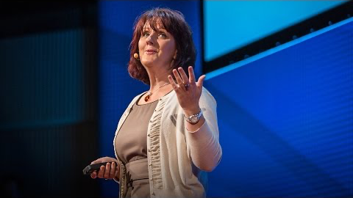
12. Security, Privacy, Anonymity
Credit: Ted Institute, Marie Wallace @ IBM
Notes:
Privacy is another important area of data science. Privacy is enshrined in U.K. law. However our privacy is now under threat, as our personal data can often reveal things about us that we’d rather keep secret. This is usually achieved via the combination of our personal data from multiple data sources. We must ensure the privacy of user data at all times, and where appropriate anonymise user data. This will help alleviate, but not necessarily solve all these issues. The following video (https://youtu.be/8JLzs_xVKxY) explores some modern concerns surrounding data privacy.

Slide 15
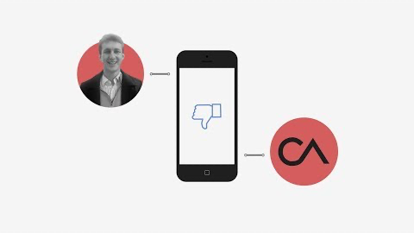
13. Legal Consequences
When privacy, and anonymity are are overlooked, things can go very wrong.
For example, the Cambridge Analytica scandal.
Here a company exploited multiple data sources to probe & manipulate our emotions.
The legality of these actions has been questioned & fines levied – yet the ethical impact is profound.
It has raised concerns about the validity of elections, discourse, and the stability of our democracy.
All brought about by a small number of data scientists.
Credit: New York Times
Notes:
When privacy, and anonymity are are overlooked, things can go very wrong. In recent years there has been a significant political scandal which begin in the U.K., with the help of big hitters in Silicon Valley, and some data scientists. This is the Cambridge Analytica scandal. This is a tale of how a company was able to exploit multiple data sources to probe and then manipulate our emotions. Whilst the legality of these actions has been brought into question, with fines levied against Facebook, the ethical impact of this saga is profound. The affair has raised concerns about the validity of election results, the nature of political discourse, and the stability of our democracy. All this was brought about by a small number of data scientists. This is why it’s hard to overstate the importance of ethics in this area. Please watch the video shown on the slide to get an insight into what happened (https://youtu.be/mrnXv-g4yKU).

Slide 16

14. Ethical Consequences
Credit: The Guardian
Notes:
Now let’s take the opportunity to hear from a data scientist at the centre of the Cambridge Analytica scandal. The enormity of the ethical mistakes he’s made have not been lost on him. Please watch the video when ready (https://youtu.be/FXdYSQ6nu-M).

Slide 17
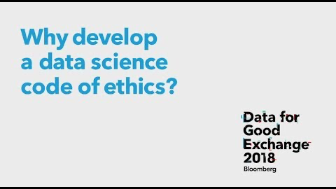
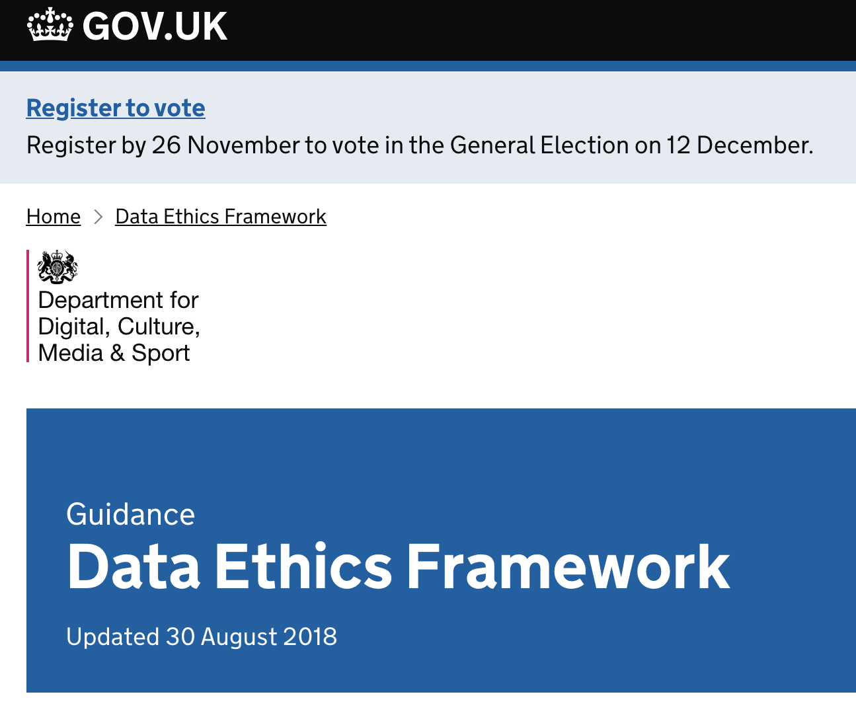
15. Code of Ethics
Credit: Inside Bloomberg
Notes:
In recent years a data science code of ethics has been created. Such codes aim to supplement the legal frameworks within which we hopefully operate.
Such codes can help instil an ethically responsible culture within data science that benefits society as a whole.
It is up to individual data scientists to adhere to the code, and be guided by it’s principles.
Codes such as this are a supplement to your own moral codes. When ready watch the video shown on the slide to hear more about one such code of conduct (https://youtu.be/s8qjmImu1LQ).
The U.K. government has even developed it’s on data ethics framework in recent years: https://www.gov.uk/government/publications/data-ethics-framework/data-ethics-framework. This is a resource you can use in your data science careers moving forward.

Slide 18
16. Summary
We’ve considered:
What Ethics is.
Covered some introductory ethical theories.
Explained the importance of ethics in data science.
Been made aware of the legal frameworks within which we should operate ethically.
Heard about GDPR, codes of ethics, and the consequences of discarding ethical. considerations.
1. Legal Framework (GDPR)
2. Code of Conduct
3. Governmental & Personal
Ethical Framework
Notes:
We’ve considered,
What Ethics is.
Covered some introductory ethical theories.
Explained the importance of ethics in data science.
Been made aware of the legal frameworks within which we should operate ethically.
Heard about GDPR, codes of ethics, and the consequences of discarding ethical considerations.
It is clear that ethics plays a crucial role in modern data science. It’s incumbent on us all to operate ethically in this sphere for the benefit of all. There is no sure-fire way to do this, as there are lots of grey areas. My advice is to operate within the legal frameworks set out for us, then within the codes of conduct within our industry, and finally within governmental and our own ethical frameworks. This should protect us and everyone else from things going wrong. I hope you’ve found this content interesting, and perhaps it will inspire you to delve into this topic further. We could certainly use some more ethically minded data scientists in the world!

Slide 19
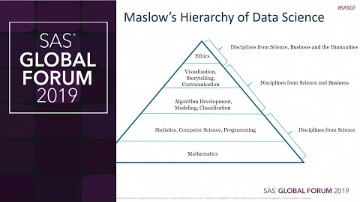
17. Resources
Credit: SAS Users
Notes:
Before you go, we have one final video (https://youtu.be/AnU0hm7uA_k) resource to get you thinking. This video tackles everything we’ve talked about so far – why data scientists need to understand ethics.

